Slide 1

.NET Core: Developing Cross-Platform Web Apps with ASP.NET Core – WorkshopPLUS
< Engineer Name >
Premier Field Engineer
v3.1

Slide 3
How to View This Presentation
To switch to Notes Page view:
On the ribbon, click the View tab, and then click Notes Page
To navigate through notes, use the Page Up and Page Down keys
Zoom in or zoom out, if required
In the Notes Page view, you can:
Read any supporting text—now or after the delivery
Add notes to your copy of the presentation, if required
Take the presentation files home with you
Notes:
Terminology List:

Slide 4
Module 2: Models and EF Core
Module Overview
Notes:
After completing this module, you will be able to:
Understand the role of Models.
Develop Models.
Understand advanced models.

Slide 5
Module 2: Models
Section 1: MVC Design Pattern
Lesson: Overview
Notes:
After completing this lesson, you will be able to:
Understand the MVC design pattern and how the control flows between Controller, Model, and View.
Why should you learn this material?
It will lay the foundational understanding of MVC design pattern and how it can be used in ASP.NET applications.

Slide 6


Model View Controller (MVC) Design Pattern
2. Pass incoming parameters
3. Resultant data
Model
1. HTTP Request
6. HTTP Response
4. Pass Model
Controller
5. GUI content (HTML)
View
Notes:
The diagram in the slide section shows how Controller, Model and View interact to handle the user request.
MVC is a standard design pattern that many developers are familiar with. Some types of Web applications will benefit from the MVC framework. Others will continue to use the traditional ASP.NET application pattern that is based on Web Forms and postbacks. Other types of Web applications will combine the two approaches; neither approach excludes the other.
The MVC framework includes the following components:
Models: Model objects are the parts of the application that implement the logic for the application's data domain. Often, model objects retrieve and store model state in a database. For example, a Product object might retrieve information from a database, operate on it, and then write updated information back to a Products table in a SQL Server database.
In small applications, the model is often a conceptual separation instead of a physical one. For example, if the application only reads a dataset and sends it to the view, the application does not have a physical model layer and associated classes. In that case, the dataset takes on the role of a model object.
Views: Views are the components that display the application's user interface (UI). Typically, this UI is created from the model data. An example would be an edit view of a Products table that displays text boxes, drop-down lists, and check boxes based on the current state of a Product object.
Controllers: Controllers are the components that handle user interaction, work with the model, and ultimately select a view to render that displays UI. In an MVC application, the view only displays information; the controller handles and responds to user input and interaction. For example, the controller handles query-string values, and passes these values to the model, which in turn might use these values to query the database.

Slide 7
MVC Control Flow
User interacts with GUI with a mouse
Incoming request directed to Controller
Controller processes the request and accesses/forms a data model
GUI waits for further user interaction.
GUI rendered;
Controller sends HTTP response to browser
View transforms Model into appropriate output format
Model is passed to View by Controller
Notes:
User interacts with user interface with a mouse.
The incoming request is directed to controller.
Controller processes the request and accesses/forms a data model.
Model is passed to View by the Controller.
View transforms Model into appropriate output format
GUI rendered; Controller sends HTTP response to browser.
GUI waits for further user interaction.

Slide 8
MVC Design Pattern
Separation of Concerns (SoC)
Search Engine Optimization (SEO) and Representational State Transfer (REST) friendly URL
Test Driven Development (TDD)
Better Integration with JavaScript
Stateless design
Full control over the rendered HTML
Less code duplication; promotes maintainability
Notes:
MVC Advantages:
The ASP.NET MVC framework offers the following advantages:
SoC: The MVC pattern helps you create applications that separate the different aspects of the application (input logic, business logic, and UI logic), while providing a loose coupling between these elements. The pattern specifies where each kind of logic should be located in the application. The UI logic belongs in the view. Input logic belongs in the controller. Business logic belongs in the model. This separation helps you manage complexity when you build an application, because it enables you to focus on one aspect of the implementation at a time. For example, you can focus on the view without depending on the business logic.
It makes it easier to manage complexity by dividing an application into the model, the view, and the controller.
It does not use view state or server-based forms. This makes the MVC framework ideal for developers who want full control over the behavior of an application.
It uses a Front Controller pattern that processes Web application requests through a single controller. This enables you to design an application that supports a rich routing infrastructure.
It provides better support for test-driven development (TDD).
It works well for the Web applications that are supported by large teams of developers and for Web designers who need a high degree of control over the application behavior.
The loose coupling between the three main components of an MVC application also promotes parallel development. For example, one developer can work on the view, a second developer can work on the controller logic, and a third developer can focus on the business logic in the model.

Slide 9
Module 2: Models
Section 2: Model Fundamentals
Lesson: Role of Models
Notes:
Overview:
Role of Model.
Entity Framework.
Methods of working with Models.

Slide 10
Model
A set of .NET classes that:
Describe data that the application is working with
Implement the rules or logic for how the data can be changed/manipulated
Model state can be retrieved and stored in any form:
Relational databases
Comma-separated text files
RESTful web services
It can use any data access technology for accessing and manipulating data
Object Relational Mapping frameworks like Entity Framework (EF)
Notes:
Models
Model objects are the parts of the application that implement the logic for the application's data domain. Often, model objects retrieve and store model state in a database. For example, a Product object might retrieve information from a database, operate on it, and then write updated information back to a Products table in a Microsoft SQL Server database.
In small applications, the model is often a conceptual separation instead of a physical one. For example, if the application only reads a dataset and sends it to the view, the application does not have a physical model layer and associated classes. In that case, the dataset takes on the role of a model object.
Source: https://docs.microsoft.com/en-us/aspnet/core/mvc/overview?view=aspnetcore-3.1

Slide 11
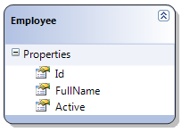
Role of a Model
The “Model” is the medium of communication between Controllers and Views
It responds to requests for information about its state (usually from view)
It changes states in the data source as per the request of controller
Controller
(Input)
View
(Presentation)
Notes:
MVC design pattern
MVC is a standard design pattern that many developers are familiar with. Some types of Web applications will benefit from the MVC framework. Others will continue to use the traditional ASP.NET application pattern that is based on Web Forms and postbacks. Other types of Web applications will combine the two approaches; neither approach excludes the other.
The MVC framework includes the following components:
Models: Model objects are the parts of the application that implement the logic for the application's data domain. Often, model objects retrieve and store model state in a database. For example, a Product object might retrieve information from a database, operate on it, and then write updated information back to a Products table in a SQL Server database.
In small applications, the model is often a conceptual separation instead of a physical one. For example, if the application only reads a dataset and sends it to the view, the application does not have a physical model layer and associated classes. In that case, the dataset takes on the role of a model object.
Views: Views are the components that display the application's user interface (UI). Typically, this UI is created from the model data. An example would be an edit view of a Products table that displays text boxes, drop-down lists, and check boxes based on the current state of a Product object.
Controllers: Controllers are the components that handle user interaction, work with the model, and ultimately select a view to render that displays UI. In an MVC application, the view only displays information; the controller handles and responds to user input and interaction. For example, the controller handles query-string values, and passes these values to the model, which in turn might use these values to query the database.
The MVC pattern helps you create applications that separate the different aspects of the application (input logic, business logic, and UI logic), while providing a loose coupling between these elements. The pattern specifies where each kind of logic should be located in the application. The UI logic belongs in the view. Input logic belongs in the controller. Business logic belongs in the model. This separation helps you manage complexity when you build an application, because it enables you to focus on one aspect of the implementation at a time. For example, you can focus on the view without depending on the business logic.
The loose coupling between the three main components of an MVC application also promotes parallel development. For example, one developer can work on the view, a second developer can work on the controller logic, and a third developer can focus on the business logic in the model.

Slide 12
Role of a Model
Building a RESTful service or WebAPI? The pattern still applies!
Web API
Client Application
Controller
(Service)
View
(Client App)
Notes:
Building a service or web API changes the pattern, but only such that the View is potentially another application!

Slide 13
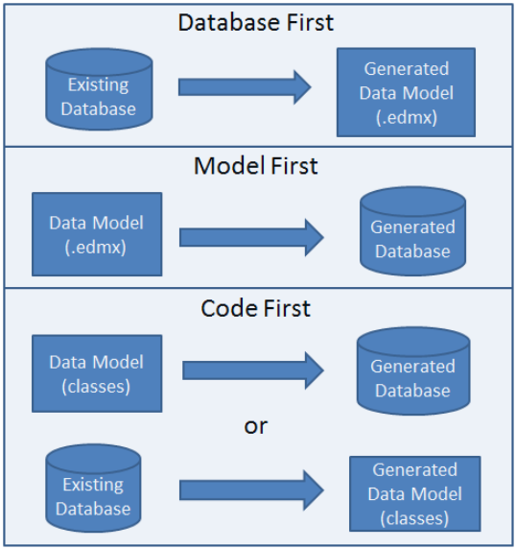
EDMX is deprecated in Entity Framework Core. It will continue to be supported in Entity Framework 6
Notes:
Database First: If you already have a database, the Entity Framework can automatically generate a data model that consists of classes and properties that correspond to existing database objects, such as tables and columns.
Model First: If you do not have a database yet, you can begin by creating a model using the Entity Framework designer in Visual Studio. This approach uses an .edmx to store model and mapping information and generate a database.
Code First: Whether you have an existing database or not, you can code your own classes and properties that correspond to tables and columns and use them with the Entity Framework without an .edmx file. This is the most common for demos and initial development.
For more information, see: https://docs.microsoft.com/en-us/aspnet/core/data/ef-mvc/?view=aspnetcore-3.1

Slide 14
Module 2: Models
Section 3: Model Development
Lesson: Development with Entity Framework
Notes:
Overview:
Entity Framework
Database First
Model First
Code First
View Specific Models

Slide 15
Entity Framework
Object-relational mapping framework by Microsoft
It understands how to store .NET objects in a relational database.
It retrieves and manipulates data as strongly typed objects using LINQ query
It provides:
Change tracking
Identity resolution
Dev-time tooling
Query translation
More!
Open-source and Cross-platform!
Both Entity Framework and Entity Framework Core will continue to develop separately
Your App
Entity Framework
Database
Notes:
Note: We’ll discuss NoSQL in a later section
The Microsoft Entity Framework is an Object/Relational Mapping (ORM) framework that enables developers to work with relational data as domain-specific objects, eliminating the need for most of the data access plumbing code that developers usually need to write. Using the Entity Framework, developers issue queries using LINQ, then retrieve and manipulate data as strongly typed objects. The Entity Framework’s ORM implementation provides services like change tracking, identity resolution, dev-time tooling, and query translation so that developers can focus on their application-specific business logic rather than the data access fundamentals.
Entity Framework is an ORM that reduces the impedance mismatch between the object-oriented world of .NET Framework developers and the world of relational databases. It enables developers to primarily interact with an application’s conceptual model, using familiar object-oriented techniques. In Entity Framework, you can work with data in the form of domain-specific objects and properties, such as customers and customer addresses, without having to concern yourself with the underlying database tables and columns where this data is stored. Developers can issue data access operations against the conceptual model, and Entity Framework translates the operations into relational database actions.
Sources:
https://docs.microsoft.com/en-us/aspnet/entity-framework
https://docs.microsoft.com/en-us/aspnet/core/data/entity-framework-6?view=aspnetcore-3.1

Slide 16

EF Architecture
EF.Commands
EF.SQLite
EF.MicrosoftSqlServer
EF.SqlServerCompact40
EF.Npgsql
PostgreSQL
EF.Relational
EF.InMemory
EntityFramework.Core
Notes:
EntityFramework.Relational holds common relational logic, i.e. mapping tables to classes and columns to properties.
https://docs.microsoft.com/en-us/ef/core/providers/index
Monolithic implementation – too many things loaded by default.
Heavy use of APIs not available on all platforms.
Built with relational mindset.
“Magic” happening everywhere by default.
Many requests from community were not implementable.
https://www.postgresql.org/
PostgreSQL: The World's Most Advanced Open Source Relational Database

Slide 17
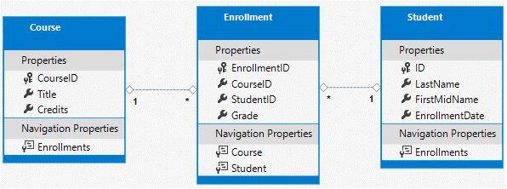
Our Data Domain – Contoso University

Slide 18
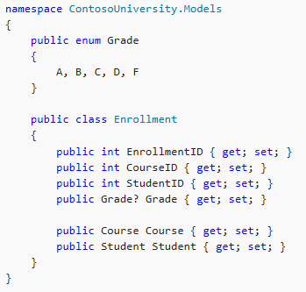
Model Development
A model can be created with a .NET class
Primary key, foreign key, and navigation properties are defined in the class
Class (Enrollment) will be converted into a database table
Class properties (EnrollmentID, CourseID, etc.) will be converted into table attributes

Slide 19
Model Relationships
Navigation property
Navigational property holds other entities that are related to this entity
Student and Course are navigation properties.
Foreign key property
It is not required in a model object
It is used for convenience
CourseID and StudentID are foreign key properties

Slide 20
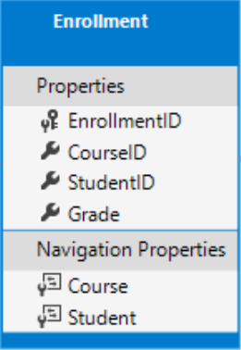
Model Relationships
Notes:
We’ll discuss how we model different relationship types in a later section

Slide 21
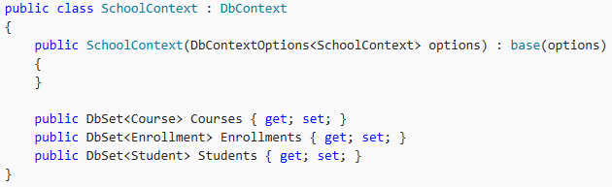
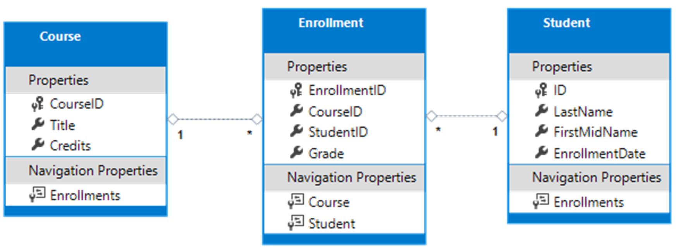
Model Relationships - DbContext
The DbContext is how we expose our classes to EF
Inherits from Microsoft.EntityFrameworkCore.DbContext
It is also our gateway into the database in code
DbSet<T> Where T is Class
How we tell EF which models to track relationships between
Here we have told EF to track Course, Enrollment, and Student entities and their relationships
Notes:
The Db

Slide 22
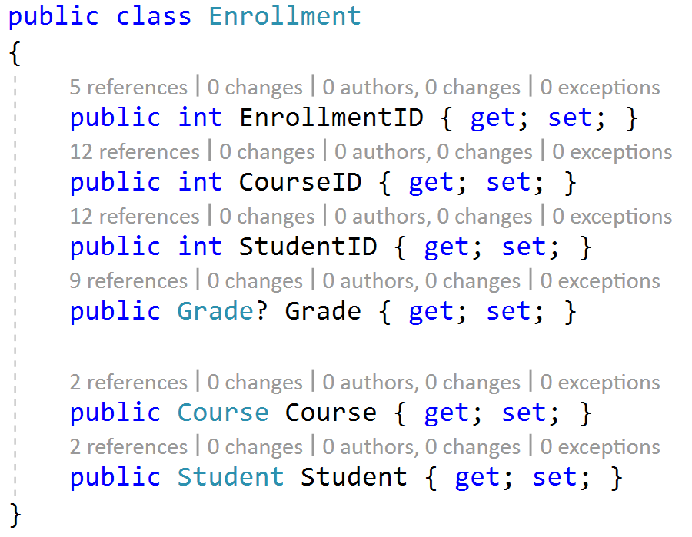
View Specific Models (DTOs)
Data Transfer Objects (DTOs) or ViewModels can be used to create versions of your Entities that can be sent over the internet
Prevents exposing schema information like relationships
Creates more specific models for an application, like a flattened search result model
Can be manually mapped or use a library like AutoMapper to move from entity to DTO and back
Notes:
The Db

Slide 23
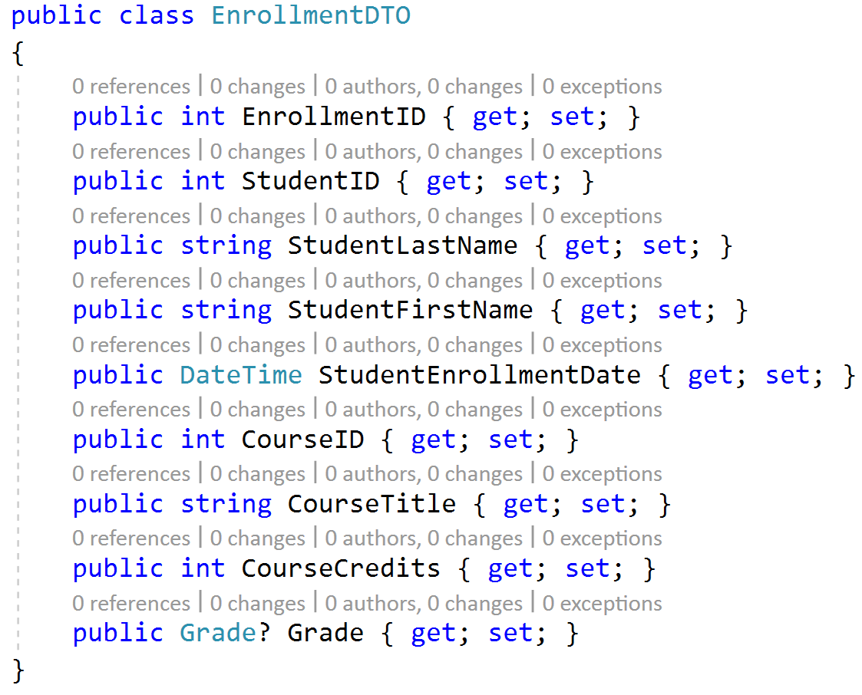
View Specific Models (DTOs)
Notes:
The Db

Slide 24
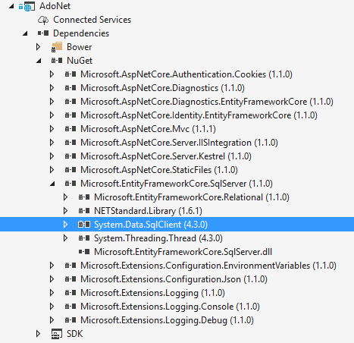
Entity Framework and ADO.NET
EF build on top of ADO.NET since first EF version.
EF generation T-SQL and than passing it to SQL Server via ADO.NET
Code on ADO.NET is faster in a runtime, because you don’t need to generate t-sql
Entity Framework code will take less time from developer

Slide 25
Demo: ADO.NET
Notes:
Demo Script:
Open project Demos\Module 02 - Models\AdoNet
Navigate to AdoNetRepository.cs file and show how ado.net working.
Explain roles of SqlConnection, SqlReader
Set a breakpoint in AccountController.Login (Post)
Start the app.
In UI register first(you can’t SignIn before registration)
After successful registration – sign out.
Next- Login with you recently created credentials.
When the code will stopped on a first line of action- once again step by step shot how ado.net working.
As a last moment- open references for Microsoft.EntityFrameworkCore.SqlServer and show that System.Data.Client already referencing in your project and EF using ado.net connection.

Slide 26
What is Entity Framework Core?
Light-weight and extensible version of Entity Framework
Open Source
New platforms
ASP.NET Core, Windows Store, etc.
Linux
Mac
Edmx is discontinued
Notes:
EF Core is a lightweight and extensible version of Entity Framework that enables new platforms and new data stores. Starting with EF Core, Windows Phone, Windows Store, ASP.NET Core, and traditional desktop application can all now take advantage of Entity Framework. In addition to relational databases, EF Core also supports non-relational data stores such as Azure Table Storage and Redis.
Open Source:
EntityFramework.codeplex.com
Not just the code but also the following:
Source code
Nightly builds
Issue tracking
Feature specs
Design meeting notes
Accepting contributions
Only affects how we develop, not how we ship
Same license
Same support
Same quality

Slide 27
Out of Band | Release History
Entity Framework Core 3
Entity Framework Core 1 & 2
Entity Framework 6.2
Entity Framework 6.1
Runtime out-of-band (NuGet)
Tooling out-of-band (Microsoft Download Center)
Latest version “chained in” to new Microsoft Visual Studio releases
Entity Framework 6.0.2
Entity Framework 6.0.1
Entity Framework 6
Entity Framework 5
Runtime
Core components in .NET
DbContext Application Programming Interface (API) and Code First out-of-band (NuGet)
Latest version “chained in” to new Visual Studio releases
Tooling in Visual Studio
Entity Framework 4.3
Entity Framework 4.2
Entity Framework 4.1
Entity Framework 4
Runtime in .NET Framework
Tooling in Visual Studio
Entity Framework 3.5 SP1

Slide 28
Why is Entity Framework Changing?
10+ years of legacy code
Current codebase extensively uses older APIs and design patterns
APIs not available on latest platforms
Performance drag
Low resource usage is greatly desired in device and cloud scenarios
Pay-per-use model
EF 6 App Migration
EF 6 will continue to develop until EF Core reaches feature parity
Code change required for upgrade to EF Core
Notes:
As we look at what we want to achieve in EF Core, we have had to take a realistic look at our current code base. While it has served us well and allowed us to release some solid versions of EF in recent times, it is not really setup to achieve what we want to in EF Core.
The EF code base has a long history, going back to the WinFS days, with parts of the code base being more than 10 years old. The current code base makes extensive use of older APIs and design patterns. Many of the APIs that EF uses heavily are not available on the new platforms we want to target. In addition, the code base is monolithic in nature which makes it difficult to implement new features and increasingly harder to change things without breaking existing functionality.
When Entity Framework was released, its charter was more to do with the Entity Data Model vision rather than being a best-of-breed O/RM. As a result, there are many seldom used features and capabilities in the code base that hamper performance and complicate development, but are not feasible to remove due to the monolithic nature of the implementation. We also have a number of unintuitive behaviors that are engrained into the framework and hard to change or remove for the same reasons.
While using less resources is desirable on all platforms it becomes more prominent on devices as they typically have fewer resources than desktop and server machines. These concerns were not a driving factor when EF was designed and implemented. The current resource usage of EF hinders its ability to be a good data access offering on devices. We have done some investigation on lowering resource usage and found it to require architectural changes that require a very large amount of work. As we move toward cloud computing, low resource usage is also desirable as it allows greater density of applications on servers and is often directly tied to billing.
What About My EF 6 Apps
We will still continue to invest in EF 6 while we work to make EF7 Core have better feature parity with EF 6. In fact, we implemented the EF 6.1 and EF 6.1.1 releases while working on the EF7 Core code base.
Upgrade from EF 6 to EF7 Core is a key scenario for us, both in terms of existing code and existing knowledge. We will be keeping the same concepts and patterns wherever it makes sense. The upgrade to EF7 Core will require some changes to your code. Our aim is that code that uses the core functionality of the DbContext API will upgrade easily, code that makes use of the lower level APIs in EF may require more complicated changes.
Reference: http://blogs.msdn.com/b/adonet/archive/2014/05/19/ef7-new-platforms-new-data-stores.aspx

Slide 29
Code-based Modeling vs. EDMX-based Database/Model first
Source control merging, conflicts, and code reviews
Easier with C#/VB code than XML files
Developers know how to write and debug code
Edmx XML is hard to debug and understand
Ability to customize
Manipulating XML-based model is hard
Code-based modeling is less-repetitive
Convention-based code
Data Migrations
Incremental SQL script for Database schema updates without having to recreate product database
Notes:
Source control merging, conflicts, and code reviews are hard when your whole model is stored in an xml file. We have had lots of feedback from developers that simple changes to the model can result in complicated diffs in the xml file. On the other hand, developers are used to reviewing and merging source code.
Developers know how to write and debug code. While a designer is arguably easier for simple tasks, many projects end up with requirements beyond what you can do in the designer. When it comes times to drop down and edit things, xml is hard and code is more natural for most developers.
The ability to customize the model based on the environment is a common requirement we hear from customers. This includes scenarios such as multi-tenant database where you need to specify a schema or table prefix that is known when the app starts. You may also need slight tweaks to your model when running against a different database provider. Manipulating an xml-based model is hard. On the other hand, using conditional logic in the code that defines your model is easy.
Code based modeling is less repetitive because your CLR classes also make up your model and there are conventions that take care of common configuration. For example, consider a Blog entity with a BlogId primary key. In EDMX-based modeling, you would have a BlogId property in your CLR class, a BlogId property (plus column and mapping) specified in xml and some additional xml content to identify BlogId as the key. In code-based modeling, having a BlogId property on your CLR class is all that is needed.
Providing useful errors is also much easier in code. We have all seen the “Error 3002: Problem in mapping fragments starting at line 46:…” errors. The error reporting on EDMX could definitely be improved, but throwing an exception from the line of code-based configuration that caused an issue is always going to be easier.
We should note that in EF 6.x you would sometimes get these unhelpful errors from the Code First pipeline, this is because it was built over the infrastructure designed for EDMX, in EF7 Core this is not the case.
There is also an important feature that could have been implemented for EDMX, but was only available for code-based models.
Migrations allows you to create a database from your code-based model and evolve it as your model changes over time. For EDMX models, you could generate a SQL script to create a database to match your current model, but there was no way to generate a change script to apply changes to an existing database.

Slide 30
New Core
Same top level experience as EF6.x
Still DbContext/DbSet, etc.
New core
Core = metadata, change tracking, query pipeline, etc.
Easier to replace/extend components
Replace confusing APIs and behavior
Optimized for memory and CPU usage
Pay-per-play components
Notes:
https://github.com/aspnet/EntityFramework/wiki

Slide 31
Module 2: Models
Section 3: Model Development
Lesson: Code-based Modeling
Notes:
Entity Framework Core

Slide 32
Entity Framework Core only supports Code-based Modeling (that is, Code First approach)

Slide 33

Entity Framework Development Approaches
Database First (through reverse engineering)
Existing Database
Generated Data Model (classes)
Code First
Data Model (Classes)
Generated Database
Code-based modeling is the only approach supported in Entity Framework Core
Notes:
Database First
If you already have a database, the Entity Framework can automatically generate a data model that consists of classes and properties that correspond to existing database objects such as tables and columns. The information about your database structure (store schema), your data model (conceptual model), and the mapping between them is stored in XML in an .edmx file. Visual Studio provides the Entity Framework designer, which is a graphical designer that you can use to display and edit the .edmx file. The sections Getting Started With the Entity Framework and Continuing With the Entity Framework in the Web Forms tutorial series use Database First development.
Code First
Whether you have an existing database or not, you can code your own classes and properties that correspond to tables and columns and use them with the Entity Framework without an .edmx file. That's why you sometimes see this approach called code only, although the official name is Code First. The mapping between the store schema and the conceptual model represented by your code is handled by convention and by a special mapping API. If you do not yet have a database, the Entity Framework can automatically create the database for you, or drop and re-create it if the model changes. This tutorial series uses Code First development.
Source: https://docs.microsoft.com/en-us/aspnet/mvc/overview/getting-started/getting-started-with-ef-using-mvc/creating-an-entity-framework-data-model-for-an-asp-net-mvc-application

Slide 34
Code-First Development
Model code is written in .NET classes; model and database are created from the code
.NET Classes correspond to database tables
Properties correspond to database table columns
Classes can be used with or without EF!
Relationships can be customized via the fluent API in the OnModelCreating override
Code First can also work with existing database
Code is used for mapping instead of visual designer and XML
Notes:
Code First generating a database
In the original prototypes of Code First, it was actually called Code Only. This was because the only thing that you needed to write was code—the model and the database were created for you. This is the approach we have demoed at conferences and have shown in walkthroughs, etc.
This approach can also be considered a model first approach depending on how you think about your model. The Model First approach described above is for people who like to create an Entity Data Model using a visual designer. However, many developers instead choose to model their application domain using just the code. This approach is often associated with Domain Driven Design (DDD) where the domain model is represented by the code. So, depending on how you view modeling and how you want to represent your model, you may also consider Code First to be a model first approach.
Having Code First generate your database for you is certainly a very powerful approach and we see a lot of people using it, but if it does not work for you then read on
Code First with an existing database
Imagine you have an existing database and maybe your DBA does not even let you modify that database. Can you still use Code First? The answer is “Yes” and we are seeing lots of people doing this. Furthermore, this is not just an afterthought; Code First has been specifically designed to support this. The steps are very simple:
Make sure your DbContext knows how to find your existing database. One way to do this is to put a connection string in your config file and then communicate to DbContext about it by passing “name=MyConnectionStringName” to the DbContext constructor.
Note: See this post for more details: http://blogs.msdn.com/b/adonet/archive/2011/03/07/when-is-code-first-not-code-first.aspx
Create the classes that you want to map to your database.
Add additional mapping using data annotations or the Code First fluent API to take care of the places where the Code-First conventions need to be overridden to get correct mappings.
This approach is essentially a database first approach, but using code for the mapping instead of a visual designer and XML. We hope to make a T4 template available that would start from an existing database and do the above steps for you—we would like to hear from you if you would find such a template useful.
Code First != DbContext
The first time most people see DbContext is when using Code First. However, DbContext can also be used together with an EDMX file for traditional Database First and Model First development. The T4 templates that shipped with CTP5 and that will ship as part of EF 4.1 create a context class derived from DbContext. This is not a Code First context and it will not build a model from data annotations or fluent API calls. Instead it loads the EDMX file at runtime (just like ObjectContext does) and uses the mappings defined in that file. This gives you the improved API surface of DbContext while maintaining the Database First or Model First approach.
It is also possible to use Code First to create an ObjectContext instead of a DbContext. However, we generally do not recommend that you use this approach.
So is Code First right for me?
The bottom line on whether Code First is right for you depends on how you like to create and store your C#/VB classes and the mapping between those classes and the database. If you like to use code for this, then Code First is probably for you. This is true even if you do not want the code to create the database, possibly because it already exists and/or is locked down by your DBA.
If you prefer a visual designer and XML files, then Database First or Model First is probably better for you.
Source: http://blogs.msdn.com/b/adonet/archive/2011/03/07/when-is-code-first-not-code-first.aspx

Slide 35
Code-First Approach: Pros and Cons
Pros
Can realize complicated domain requirements
Can have a very clean and elegant domain model that is represented with Plain Old CLR Object (POCO)
Not tied with Entity Framework
Cons
Needs more effort in creating domain classes
Needs to map the domain model to data model (with Data Annotations)

Slide 36
Tooling
Entity Framework Core dotnet CLI – Our dev/design-time tooling
Add the following to your .csproj file
Enables dotnet ef * commands at the command line in the project directory, e.g.,
dotnet ef migrations add Initial
dotnet ef database update Initial
dotnet ef dbcontext scaffold …
<PackageReference Include="Microsoft.EntityFrameworkCore.Tools" Version="3.1.0">
<PrivateAssets>all</PrivateAssets>
<IncludeAssets>runtime; build; native; contentfiles; analyzers; buildtransitive</IncludeAssets>
</PackageReference>
.csproj
Note: version above may not be current, check docs when adding
Notes:
As of dotnet core 2.0, this CANNOT be done via dotnet package install or install-package, and must be done manually

Slide 37
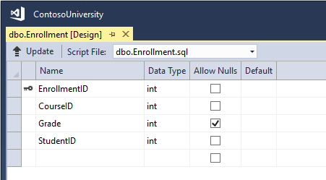
Database Creation Using Entity Framework - I
Model is created using .NET classes
Executed using dotnet ef CLI tooling
Notes:
With Code First, Entity Framework creates database and its entities (tables/table columns) using the model class in .NET using Code First conventions.
Can be done without migrations, but this is less flexible

Slide 38
Database Creation Using Entity Framework - II
Tooling scans project for Microsoft.EntityFrameworkCore.DbContext based classes
Contexts are used as the entry point into your code base
We can override or reinforce how EF interprets relationships via the fluent API
For example, EF will create Students, Enrollments and Courses tables in the database
Notes:
We’ll show an example of the fluent API in the demo

Slide 39
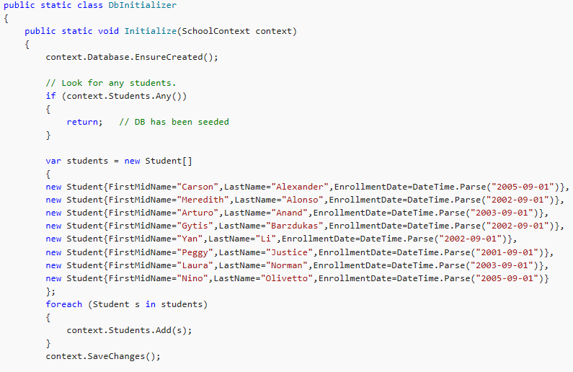
Database Seeding
Database Initializers are deprecated in EF Core
Use DI to write and inject your own
This code should be executed in Main, outside your app
Notes:
Complete method:
using ContosoUniversity.Models;
using System;
using System.Linq;
namespace ContosoUniversity.Data
{
public static class DbInitializer
{
public static void Initialize(SchoolContext context)
{
context.Database.EnsureCreated();
// Look for any students.
if (context.Students.Any())
{
return; // DB has been seeded
}
var students = new Student[]
{
new Student{FirstMidName="Carson",LastName="Alexander",EnrollmentDate=DateTime.Parse("2005-09-01")},
new Student{FirstMidName="Meredith",LastName="Alonso",EnrollmentDate=DateTime.Parse("2002-09-01")},
new Student{FirstMidName="Arturo",LastName="Anand",EnrollmentDate=DateTime.Parse("2003-09-01")},
new Student{FirstMidName="Gytis",LastName="Barzdukas",EnrollmentDate=DateTime.Parse("2002-09-01")},
new Student{FirstMidName="Yan",LastName="Li",EnrollmentDate=DateTime.Parse("2002-09-01")},
new Student{FirstMidName="Peggy",LastName="Justice",EnrollmentDate=DateTime.Parse("2001-09-01")},
new Student{FirstMidName="Laura",LastName="Norman",EnrollmentDate=DateTime.Parse("2003-09-01")},
new Student{FirstMidName="Nino",LastName="Olivetto",EnrollmentDate=DateTime.Parse("2005-09-01")}
};
foreach (Student s in students)
{
context.Students.Add(s);
}
context.SaveChanges();
var courses = new Course[]
{
new Course{CourseID=1050,Title="Chemistry",Credits=3},
new Course{CourseID=4022,Title="Microeconomics",Credits=3},
new Course{CourseID=4041,Title="Macroeconomics",Credits=3},
new Course{CourseID=1045,Title="Calculus",Credits=4},
new Course{CourseID=3141,Title="Trigonometry",Credits=4},
new Course{CourseID=2021,Title="Composition",Credits=3},
new Course{CourseID=2042,Title="Literature",Credits=4}
};
foreach (Course c in courses)
{
context.Courses.Add(c);
}
context.SaveChanges();
var enrollments = new Enrollment[]
{
new Enrollment{StudentID=1,CourseID=1050,Grade=Grade.A},
new Enrollment{StudentID=1,CourseID=4022,Grade=Grade.C},
new Enrollment{StudentID=1,CourseID=4041,Grade=Grade.B},
new Enrollment{StudentID=2,CourseID=1045,Grade=Grade.B},
new Enrollment{StudentID=2,CourseID=3141,Grade=Grade.F},
new Enrollment{StudentID=2,CourseID=2021,Grade=Grade.F},
new Enrollment{StudentID=3,CourseID=1050},
new Enrollment{StudentID=4,CourseID=1050},
new Enrollment{StudentID=4,CourseID=4022,Grade=Grade.F},
new Enrollment{StudentID=5,CourseID=4041,Grade=Grade.C},
new Enrollment{StudentID=6,CourseID=1045},
new Enrollment{StudentID=7,CourseID=3141,Grade=Grade.A},
};
foreach (Enrollment e in enrollments)
{
context.Enrollments.Add(e);
}
context.SaveChanges();
}
}
}

Slide 40
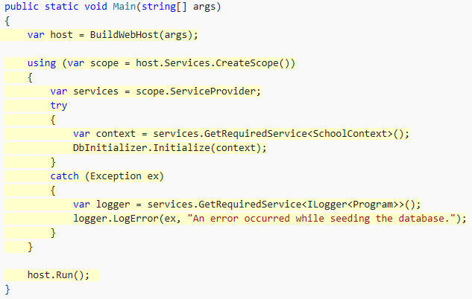
Database Seeding
Database Initializers are deprecated in EF Core
Use DI to write and inject your own
This code should be executed in Main, outside your app
Program.cs
Notes:
Older tutorials may put this code in Startup.Configure(), this is no longer considered best practice. Best practice as of August 2017 is to run this in Main outside of your app.
Note that we created our host, then used it before running! This means we can do a lot of one time things here before we ever actually run our code!

Slide 41
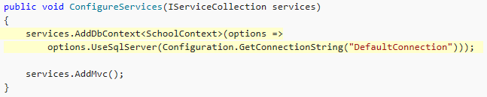
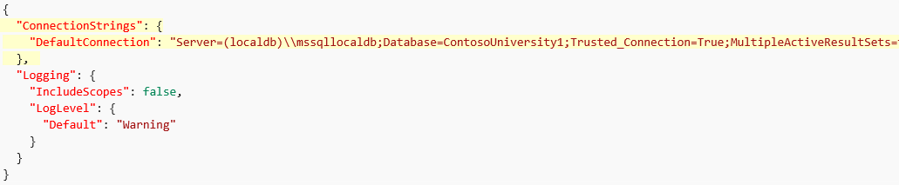
Configuring Connections with Entity Framework
Database connection string is typically stored in configuration (often appsettings.json)
Startup.cs
appsettings.json
Notes:
If connection is not specified, EF uses convention:
Uses new instances of LocalDb
Database is named the same as the DBContext derived class.
If database is not found, a new database instance is created.
NOTE (since 2.0): Do not use services.UseEntityFramework, as this messes with the internal services container that Entity Framework uses and doesn’t perform the same task as services.AddDbContext(…)

Slide 42
Code First Migrations
Enables changing the data model and deploying the change in production without dropping and re-creating the database
Effective strategy for real-world production databases
Up method used for creating/updating database schema
Down method used for rollback logic
Maintains version of each change
Not required, but are very helpful if your schema changes
Notes:
A constantly changing schema may mean that you are either managing your data poorly or your code is not primetime ready yet

Slide 43
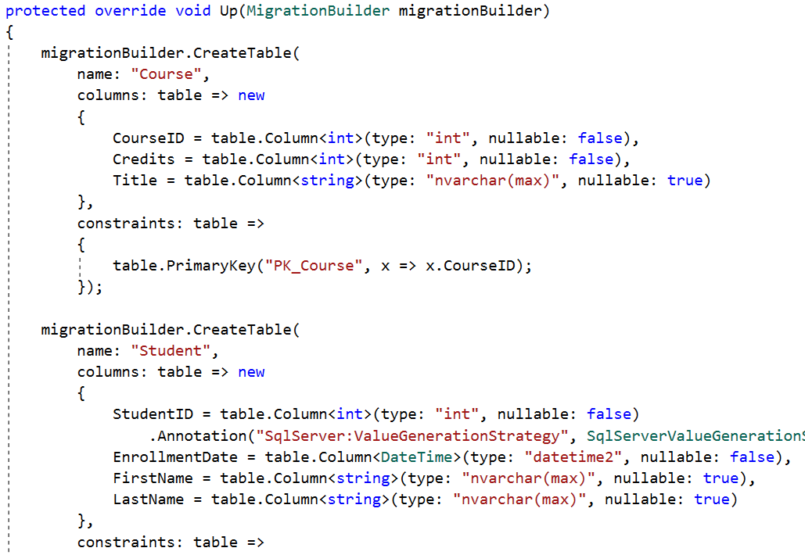
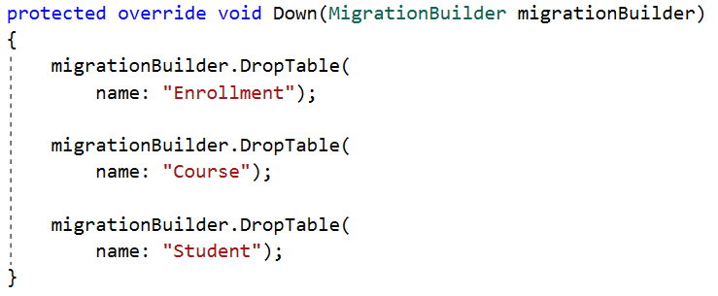
Migration Methods
Up Method
Down Method
Notes:
These methods are used for creating database schema for ContosoUniversity

Slide 44

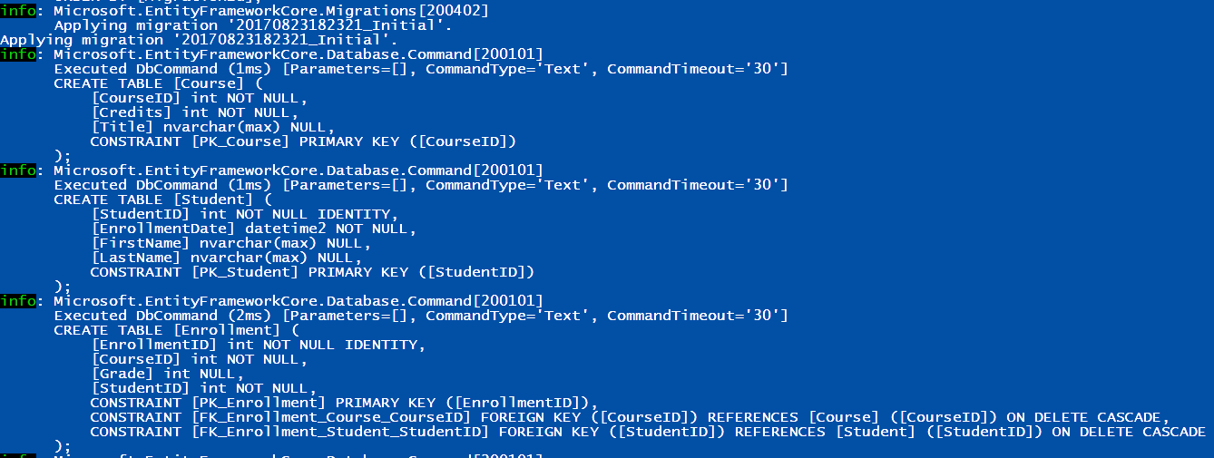
Creating and Applying Migrations
$ dotnet ef migrations add Initial
$ dotnet ef database update Initial
Notes:
Dotnet ef migrations add Initial creates a migration named Initial
Dotnet ef database update Initial applies the migration named Initial

Slide 45
Entity Framework Tools & CLI
Since .NET Core 3.0 the dotnet ef command line tool is no longer included in .NET Core SDK
You have to install it as a global or local tool
Following command installs tool globally
Following command scaffolds all schemas and tables and put the new files in Models folder
dotnet tool install --global dotnet-ef --version 3.1.0-*
dotnet ef dbcontext scaffold "Server=(localdb)\mssqllocaldb;Database=Blogging;Trusted_Connection=True;" Microsoft.EntityFrameworkCore.SqlServer -o Models
Notes:
You can use EF tools from CLI (.net command line interface) or from Visual Studio
https://docs.microsoft.com/en-us/ef/core/miscellaneous/cli/dotnet

Slide 46
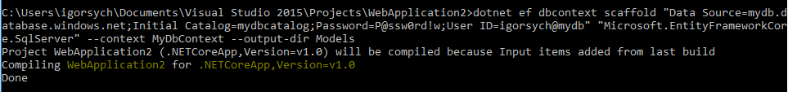
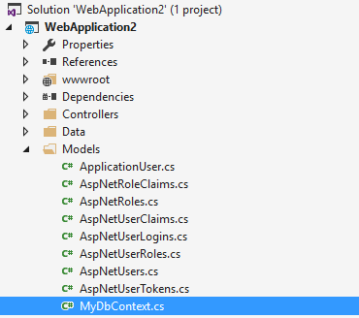
Entity Framework Tools & CLI
Notes:
You can use EF tools from CLI (.net command line interface) or from Visual Studio

Slide 47
Demo: Entity Framework Code First
Notes:
You should do one of the two demos provided here (slide 48 “explains Migrations” and 49 “a limited approach for classes with less web dev experience”).
Open Module2 Solution then ContosoUniversity.demo2 in Demo 2 – Code-First DB Creation (or use the end result of demo 1)
Run through the DemoScript.txt in the project

Slide 48
Demo: CRUD using EF
Notes:
Demo Script:
Open project Demos\Module 02 - Models\ModelsDemo and show the logic of working with EF in BlogController

Slide 49
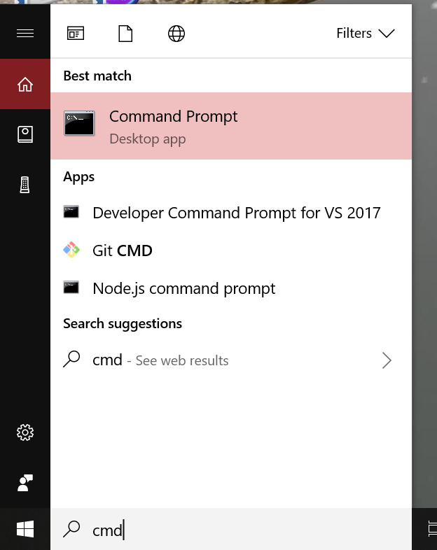
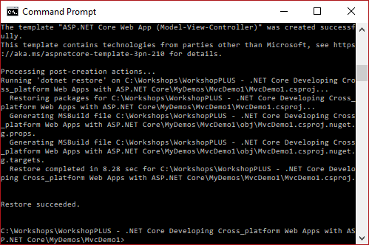
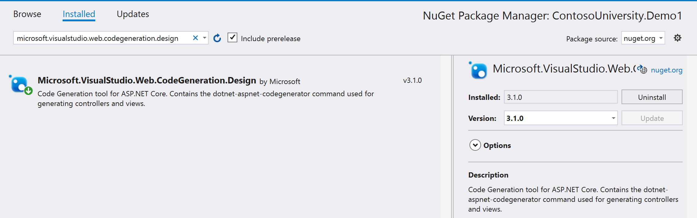
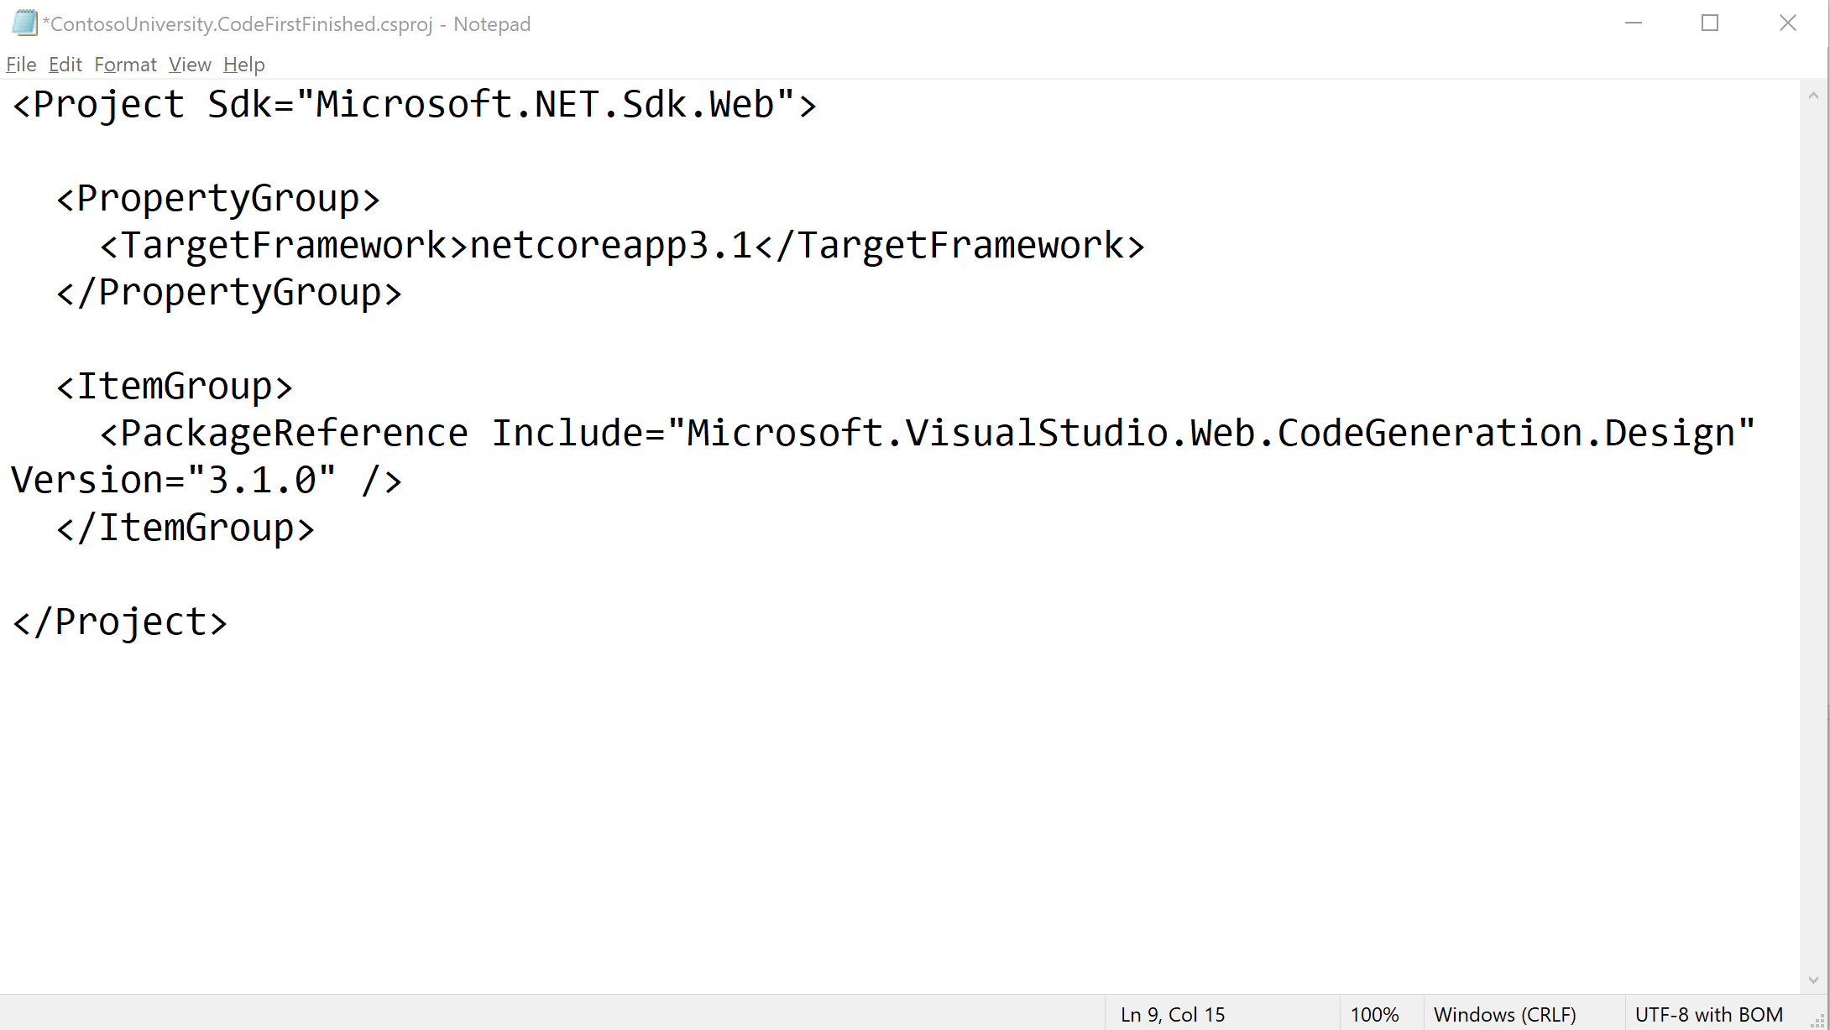
Notes:
Steps:
Create MVC Web App using cmd window (just for show).
Mkdir MvcDemo
Cd MvcDemo
Dotnet new mvc
Add models
Add class to models folder Employees.cs public class Employees
{
public int Id { get; set; }
[Required]
public string Name { get; set; }
[Required]
public string City { get; set; }
[Required]
public string Department { get; set; }
[Required]
public int Salary { get; set; }
}
Create Views and Controller using scaffolding
Add Nugget package Microsoft.VisualStudio.Web.CodeGeneration.Design
Once done open the MvcDemo1.csproj file in NotePad and show the packages loaded.
Add MVCEmployeeContext.cs file in our Model folder
Code public class MvcEmployeeContext : DbContext
{
public MvcEmployeeContext (DbContextOptions<MvcEmployeeContext> options)
: base(options)
{
}
public DbSet<MvcDemo.Models.Employees> Employee { get; set; }
}

Slide 50
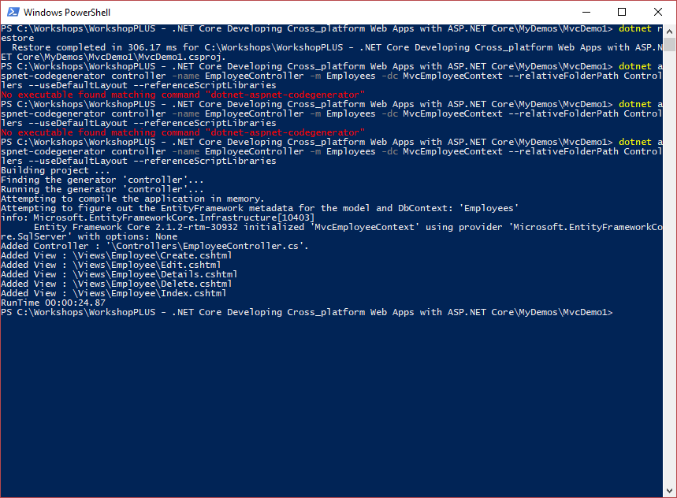
Notes:
Scaffold the controller and Razor view files
Steps:
Add the following to the csproj file. <ItemGroup>
<DotNetCliToolReference Include="Microsoft.VisualStudio.Web.CodeGeneration.Tools" Version="2.0.0" />
<DotNetCliToolReference Include="Microsoft.EntityFrameworkCore.Tools.DotNet" Version="2.0.0" />
</ItemGroup>
Press and hold Shift and right click, it will give you the option to “open PowerShell window here “as shown in image below. Click and it will open a PowerShell window.
Run the following commands in powerShell
dotnet restore
dotnet aspnet-codegenerator controller -name EmployeeController -m Employees -dc MvcEmployeeContext --relativeFolderPath Controllers --useDefaultLayout --referenceScriptLibraries
Review created code

Slide 51
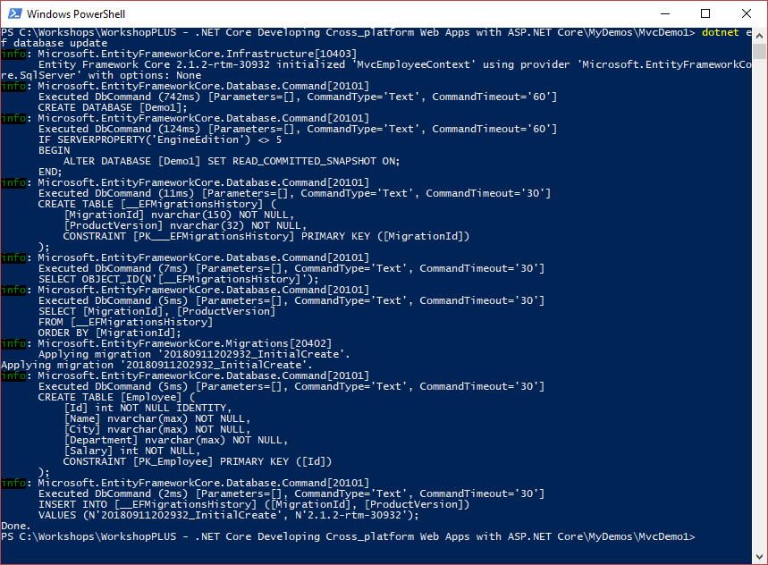
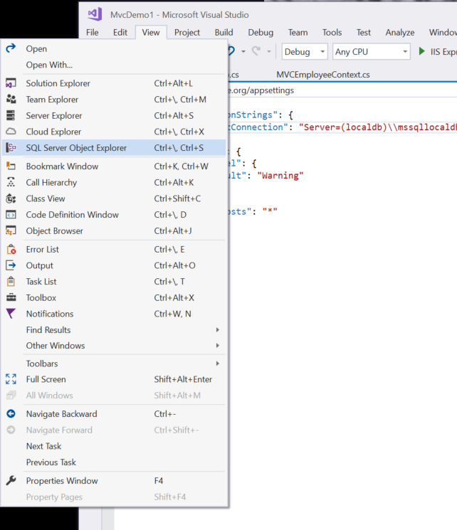
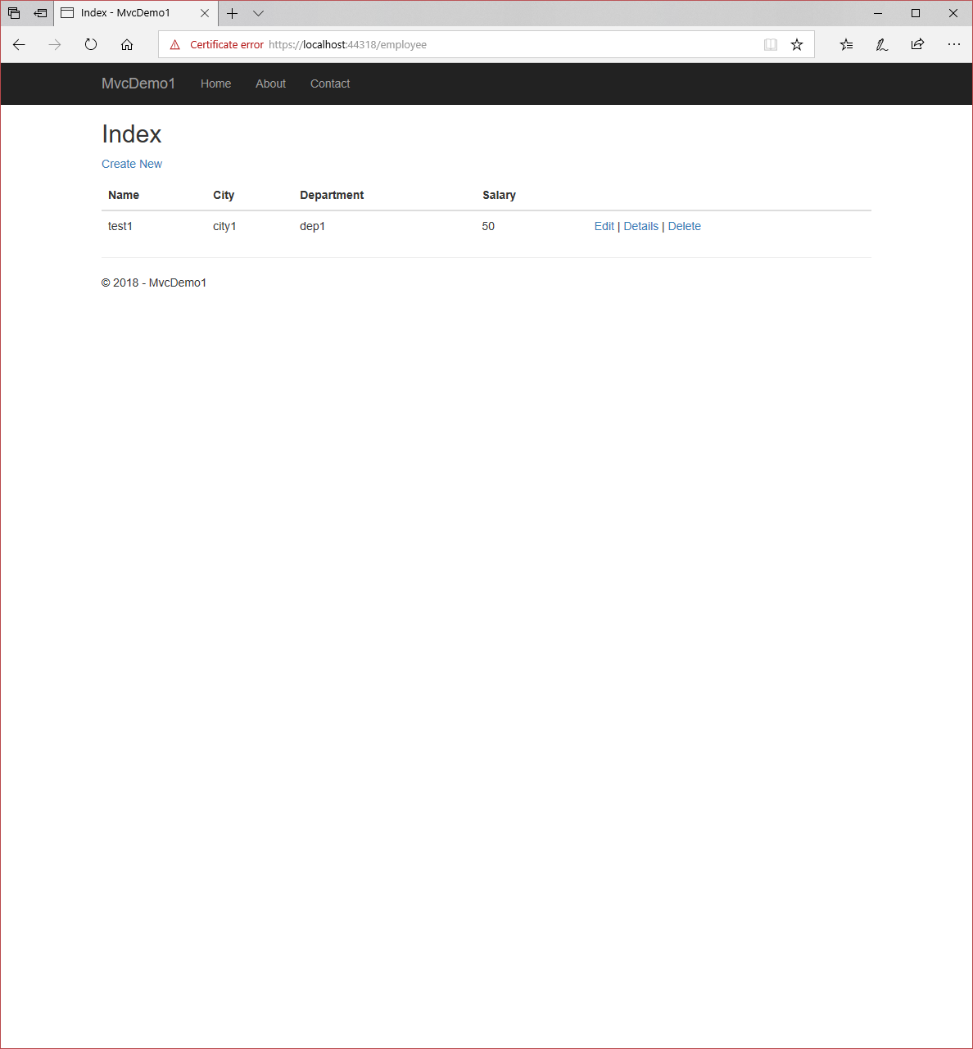
Notes:
Initial Migration of Database
Steps:
Add the following to the appsettings.json file. "ConnectionStrings": {
"DefaultConnection": "Server=(localdb)\\mssqllocaldb;Database=Demo1;Trusted_Connection=True;MultipleActiveResultSets=true"
},
Open PowerShell in Project folder and run the following commands
dotnet ef migrations add InitialCreate
dotnet ef database update
Show the database
Run App

Slide 52
Code First (Existing Database)
Database schema reverse-engineered to Model classes
Creates POCO classes
POCO classes modified to customize database generation
Corresponding partial classes used for customization
Originally generated classes are replaced with each generation
Indexes, functions, and stored procedures ignored

Slide 53
Demo: Entity Framework Code First
(with Existing Database)
Notes:
Use this demo if asked to demo existing DB code first.
Open Module2 Solution then ContosoUniversity.demo3 in Demo 3 – Code-First Existing DB
Run through the DemoScript.txt in the project

Slide 54
Module 2: Models
Section 4: Model Design
Lesson: Code First Development

Slide 55
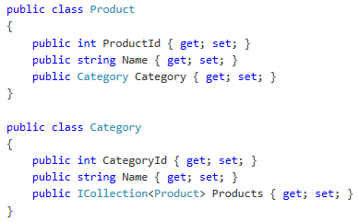
Code-First Conventions - I
Naming
Class Name or Object Type ➔ Table Name
Primary Key
Property named ‘Id’ or ‘<class name>Id’ ➔ Primary key value
Auto-increment is set for primary key values
Relationship Inverses
Both types define only one navigation property
Product.Category and Category.Products represents different ends of the same relationship
Notes:
Conventions for Code First: http://blogs.msdn.com/b/efdesign/archive/2010/06/01/conventions-for-code-first.aspx

Slide 56
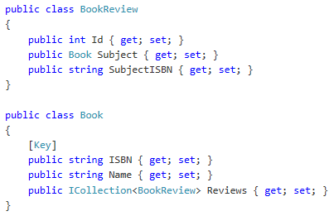
Code-First Conventions - II
Type Discovery
Referenced object types are automatically included in the model without explicitly registering them as object sets
Foreign Keys
Following conventions are used for foreign keys:
<navigation property name><primary key property name>
that is, ‘SubjectISBN’; <principal class name><primary key property name>
that is, ‘BookISBN’; <primary key property name> that is, ‘ISBN’;
Code-First conventions can be overridden using Data Annotations, which can in turn be overridden using Fluent API
Notes:
Conventions for Code First: http://blogs.msdn.com/b/efdesign/archive/2010/06/01/conventions-for-code-first.aspx
When working with Entity Framework Code First the default behavior is to map your POCO classes to tables using a set of conventions baked into EF. Sometimes, however, you cannot or do not want to follow those conventions and need to map entities to something other than what the conventions dictate.
There are two main ways you can configure EF to use something other than conventions, namely annotations or EFs fluent API. The annotations only cover a subset of the fluent API functionality, so there are mapping scenarios that cannot be achieved using annotations
The code first fluent API is most commonly accessed by overriding the OnModelCreating method on your derived DbContext.
[Required]
Name
or
modelBuilder.Entity<Department>().Property(t => t.Name).IsRequired();
For more information:
https://docs.microsoft.com/en-us/ef/ef6/modeling/code-first/fluent/types-and-properties
https://docs.microsoft.com/en-us/ef/ef6/modeling/code-first/fluent/relationships

Slide 57
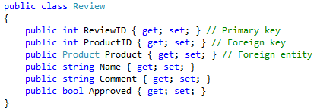
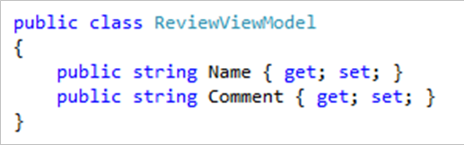
View-Specific Model
It is a model that exists just to supply information to a view
It is mostly used for views that show accumulated data from different tables
It is also used to prevent “over-posting” attack
Model created to exclude Approved status
Notes:
In the above example, View Specific Model is used to prevent “over-posting” attack. Review model has six properties (containing primary key, foreign key, foreign entity, and standard table properties). In order to prevent a malicious user from posting any value for “Approved” column in the query string, ReviewViewModel has restricted the number of model properties to two, that is, Name and Comment. Hence, a malicious user is restricted to only post values for Name and Comment columns; malicious user cannot “over-post” any other value since it does not exist in the view specific model and defaultModelBinder only accepts values for columns that exist in model.

Slide 58
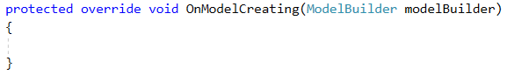
EF Core Fluent API
Used inside of the OnModelCreating override in your DbContext
As of 2.0, can be defined in their own class and invoked inside OnModelCreating
Can be used to override convention, explicitly define relationships, define custom conventions

Slide 59
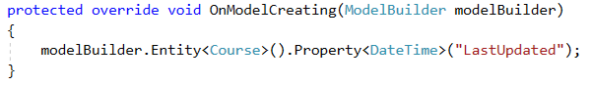
EF Core Fluent API – Shadow Properties
A Shadow Property is a property that is not defined on your code class, but does exist logically on the entity (and in the datastore)
Example: a class with a navigation property, but no foreign key, must logically have a foreign key defined for the navigation property
They can only be accessed via the EF API
EF can implicitly create them, or you can explicitly define them via the fluent API
Create a shadow property
Use a shadow property in a LINQ query
Get/Set the value of shadow property
Notes:
Can be used anywhere a regular property can be, e.g., queries, CRUD operations, etc.
The picture here adds a shadow property named LastUpdated with a type of DateTime

Slide 60
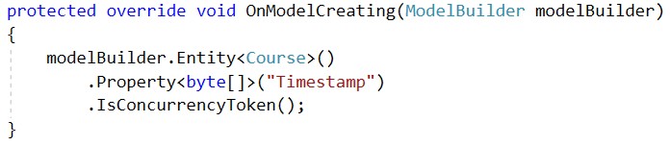
EF Core Fluent API – Concurrency Token
A Concurrency Token is the property on a model EF will use to determine if it has been modified since retrieved
Timestamps are often used as concurrency tokens
Can be marked via ConcurrencyCheckAnnotation or Fluent API
Can be applied to Shadow Properties and regular properties
Create Shadow Property
Mark as Concurrency Token
Notes:
Can also use .IsRowVersion() which chains two calls .ValueGeneratedOnAddOrEdit().IsConcurrencyToken()

Slide 61
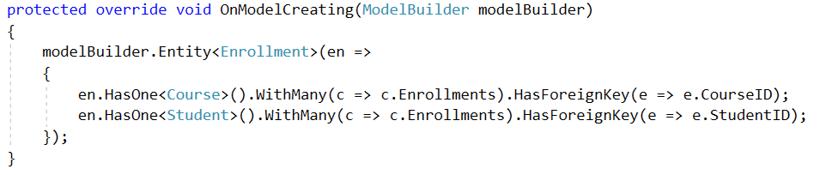
EF Core Fluent API – Relationships
Relationships can be explicitly defined using the fluent API
Notes:
Note: HasOne needs to be followed by either WithOne or WithMany, and vice versa and often these need to explicitly state the ForeignKey in order to cement the relationship (since we’re overriding the default)

Slide 62
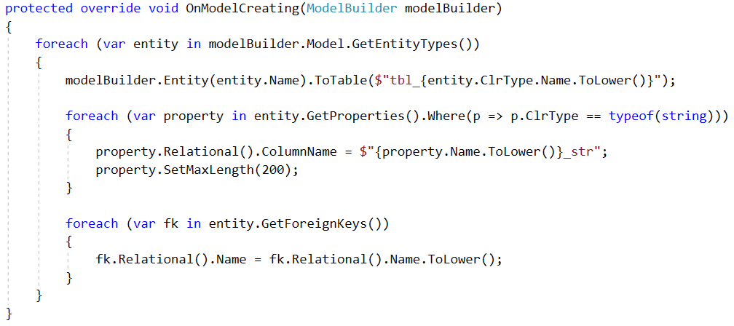
EF Core Fluent API – Conventions
Default conventions can be overridden using the Fluent API

Slide 63
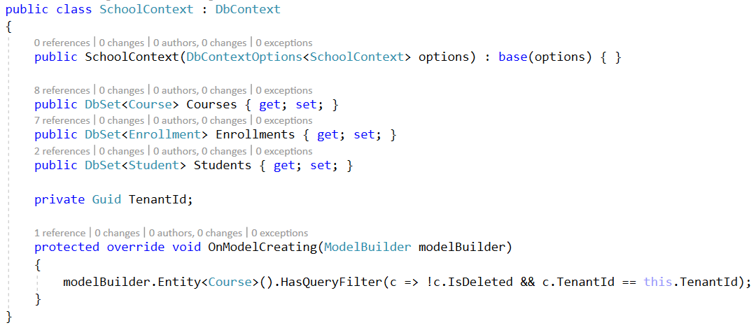
EF Core Fluent API – Model-Level Query Filters
Create a filter at the model level that filters all queries on that entity type
Notes:
Helpful in situations like soft delete (IsDeleted), or multitenancy (TenantId)

Slide 64
Module 2: Models
Section 3: Model Design
Lesson: Scaffolding
Notes:
This will be covered in the labs
A model can be created with a .NET class. Private key, foreign key, and navigation properties are defined in the class.

Slide 65
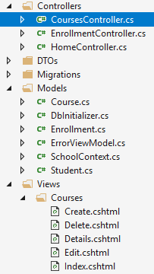
Scaffolding
It means generating code for Create, Read, Update, and Delete (CRUD) functionality against a model
It examines the type definition of model(s) to:
Generate controller(s)
Generate Controller’s associated views
It automatically names controllers and views
All the generated controllers and views are placed correctly in the project structure
Notes:
For example, StudentController and 5 views (Views ➔ Student directory) are automatically generated through scaffolding.

Slide 66
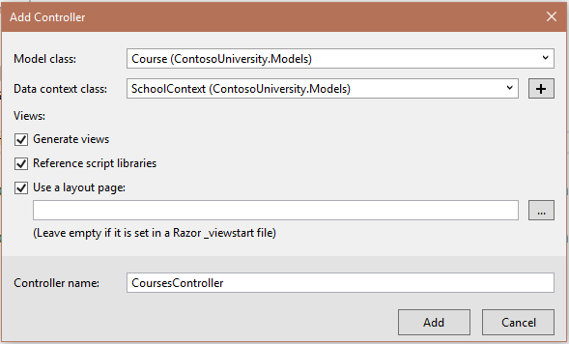
ASP.NET MVC Scaffolding in Visual Studio

Slide 67
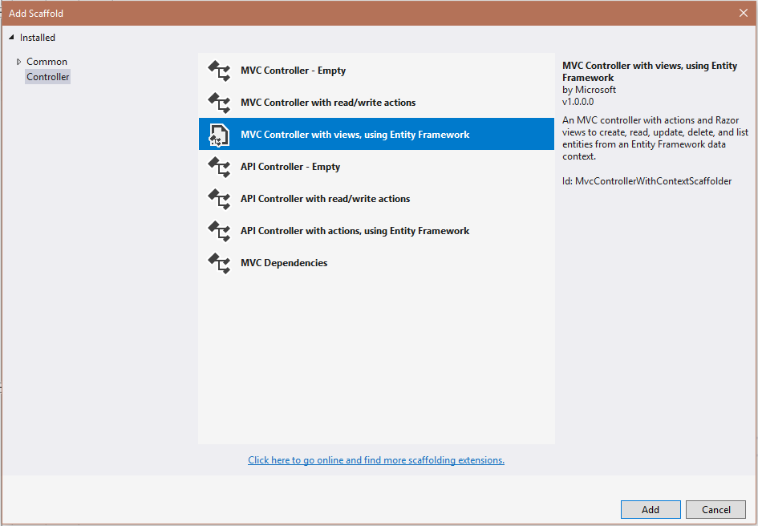
Scaffolding Templates
Scaffolding template determines how far would it go with code generation
Alternative scaffolding templates are available through NuGet

Slide 68
Demo: Scaffolding Model Development
Notes:
Open Module.sln and navigate to “Demo 4 – Scaffolding/ContosoUniversity.Demo4”
Follow the DemoScript.txt in that project

Slide 69
Module 2: Models
Section 3: Model Design
Lesson: Model Binding

Slide 70
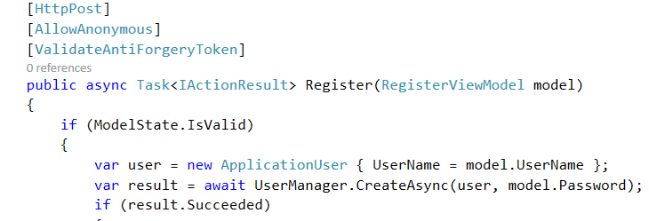
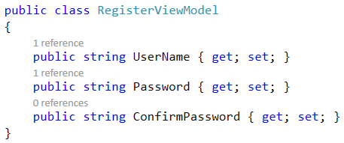
Model Binding
Model binder: Automatically maps posted form value to a .NET framework type based on naming conventions
Default Model Binder is a default Model Binder implementation
Takes care of mundane property mapping and type conversion
Uses the name attribute of input elements
Automatically matches parameter names for simple data types
Complex objects are mapped by property name; use dotted notation
Notes:
RequestForm: Values provided from a submitted HTML form.
RouteDataValues: Values obtained from application routes.
RequestQueryString: Data from query string portion of the request URL.
RequestFiles: Files uploaded in the request.
MVC supports multiple model binders and each binder can bind one or more model types. DefaultModelBinder is used by the action invoker when it cannot find a custom binder for the given type. It searches five locations (JSON) by the name of the parameter and the name of the request data item it must match. The binder tries to convert the string value from the request into the parameter type using the - DefaultModelBinder uses different culture settings to perform type conversions. When the action invoker needs to call an action method, it looks at the parameters that the method defines and finds the responsible binder for each parameter type. A model binder is responsible for generating suitable action method parameter values.

Slide 71
Async Query and Save
What is it?
Task based async pattern for query and save
Why did we build it?
Appropriate use of async can improve performance and scalability
When should you use it?
Reduce server resource usage by freeing up blocked threads
Improve client UI responsiveness by not blocking main thread
Parallelism – but not on the same context instance
Notes:
EF6 introduced support for asynchronous query and save using the async and await keywords that were introduced in .NET 4.5. While not all applications may benefit from asynchrony, it can be used to improve client responsiveness and server scalability when handling long-running, network or IO-bound tasks.
https://docs.microsoft.com/en-us/ef/ef6/fundamentals/async

Slide 72
Model Development Strategies
Strive for fat models and skinny controllers
Encapsulate logic in services
Private methods on controllers are a code smell
Be careful of looping references and N+1 queries
Bad LINQ queries make bad T-SQL queries
Leverage data contracts, serialization configuration, or ViewModels/Data Transfer Objects to avoid looping references
Notes:
Controllers should read like self documented code, e.g., very few lines, with descriptive function calls. Too many lines of code or logic in a Controller should indicate we can refactor logic into services that can be injected or added to the Model aspect of our application.
Looping References can happen when you attempt to serialize Entities that have navigation properties (e.g., if you query for a Student and Include Enrollments, each of those Enrollments contains a reference back to the student. If you don’t tell the serializer how to handle that, it will most likely throw an error). DTOs or ViewModels are great way to avoid this situation and create carefully tailored types for various actions, e.g., CreateDTO, EditDTO, DetailDTO, etc. Note that you will need to write some mapping code or use a tool like AutoMapper or ValueInjector.
N+1 queries: A bad LINQ query will be translated into a bad T-SQL query. Pay careful attention to how you write your queries and avoid over querying your data to prevent N+1 data retrieval.

Slide 73
Demo: Model binding
Notes:
Open Module.sln and navigate to “Demo 5 – ModelBinding/ContosoUniversity.Demo5”
Follow the DemoScript.txt in that project

Slide 74
Module 2: Models
Section 5: Entity Framework Core
Lesson: New Features

Slide 75
Migrations
Code first is only approach in EF Core – EDMX is no more.
Database provider must be specified by overriding OnConfiguring method of DbContext.
Enable-Migrations is removed, migrations are enabled by default.
Custom migrations can be created as extension methods to MigrationBuilder class.
Multiple migrations can be created before applying to database.
Notes:
EntityFramework.Commands contains everything related to migrations.
Used to be part of EntityFramework assembly in EF6.
No need to deploy EntityFramework.Commands into production.
Migration code is generated (scaffolded) from your domain model metadata discovery.
You can write your own migration that will i.e. create table which will not map to your domain model.
Examples of custom migrations:
Synonyms
Creating users and roles for packed products
Snapshot is updated whenever new migration is added to the project.
In EF Core, there is single Snapshop file for all migrations vs EF6 where each migration had its own. This helps out scenarios where two teams are making migrations – single Snapshot will display conflicts when doing push/pull.
Script-Migration command allows you to see T-SQL statements that will be sent to SQL server during Update-Database command execution.
Script-Migration –Idempotent will generate T-SQL statements that will check whether migration has been previously applied before making changes to the database.
context.Database.Migrate() will execute migrations at runtime. Useful for SQLite on phone devices scenario.
Migrations can be moved to different folder within the project. EF Core will figure it out and place new migrations to same folder.

Slide 76
New features
Shadow state / properties.
Batching during SaveChanges.
Client eval in LINQ queries.
SQL Server sequences.
Unique constraints / alternative keys.
Notes:
New core allows new features to be implemented that were not previously possible.
Multiple entity updates are not sent as single command.

Slide 77
Shadow Properties
Part of the model but not part of CLR (POCO) class.
Useful scenarios:
Property that we do not want to expose as part of the domain model but we want to develop logic over it.
Using CLR class as the domain model from a compiled assembly that we are not able to change.
Property defined in OnModelCreating in DbContext, accessible in SaveChanges in DbContext or in application code through special API.
Notes:
http://ef.readthedocs.org/en/latest/modeling/shadow-properties.html
https://channel9.msdn.com/Blogs/Seth-Juarez/Shadow-Properties-in-Entity-Framework-7
class MyContext : DbContext {
public DbSet<Blog> Blogs { get; set; }
protected override void OnModelCreating(ModelBuilder modelBuilder)
{
modelBuilder.Entity<Blog>() .Property<DateTime>("LastUpdated"); }
}
public class Blog
{
public int BlogId { get; set; }
public string Url { get; set; }
}

Slide 78
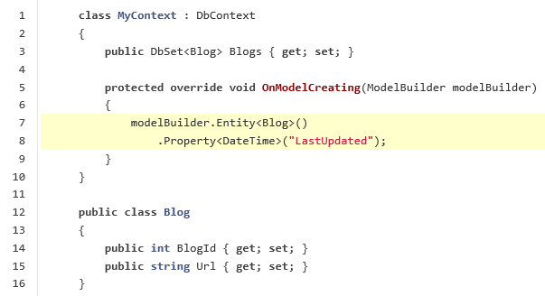
Shadow Properties Example

Slide 79
Alternate Keys
An alternate key serves as a alternate unique identifier for each entity instance in addition to the primary key.
Ability to add other unique identifiers, i.e. Personal card ID., or license plate.
Results in unique constraints on the database level.
Notes:
https://channel9.msdn.com/Blogs/Seth-Juarez/Alternate-Keys-in-Entity-Framework-7
http://ef.readthedocs.org/en/latest/modeling/alternate-keys.html
An alternate key serves as a alternate unique identifier for each entity instance in addition to the primary key. When using a relational database this maps to the concept of a unique index/constraint. In EF, alternate keys provide greater functionality than unique Indexes because they can be used as the target of a foreign key.

Slide 80
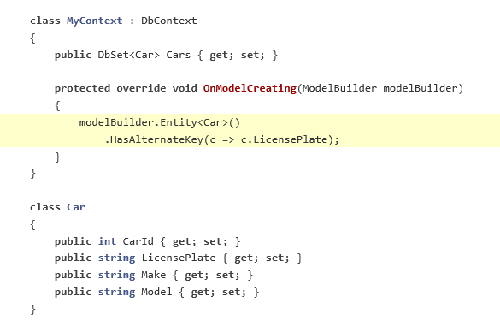
Alternate Keys Example

Slide 81
T-SQL Generation Improvements
INSERT, UPDATE & DELETE batches are now supported.
Providers are responsible for splitting batches into smaller chunks if needed by the backing server.
Added mixing of raw SQL with strongly typed LINQ queries.
Ability to include custom methods in LINQ query to be evaluated on the client side.
Reduction of duplicate data when using Include in LINQ query.
Notes:
In the past, query pipeline required for entire LINQ query to be translated into T-SQL.
With EF Core, portion of LINQ query can be evaluated in the memory.
https://channel9.msdn.com/Blogs/Seth-Juarez/SQL-Generation-Improvements-in-Entity-Framework-7

Slide 82
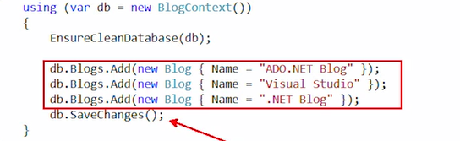
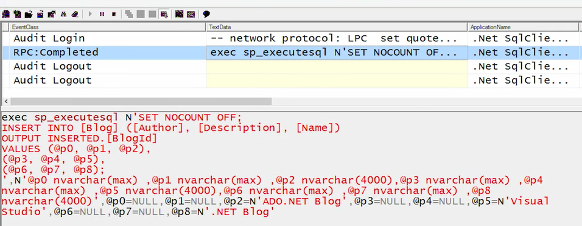
Batch
Notes:
Before EF 7- for this code was generated 3 separate inserts.

Slide 83
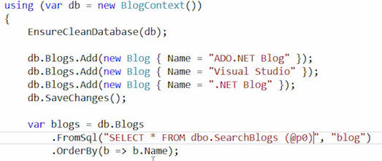
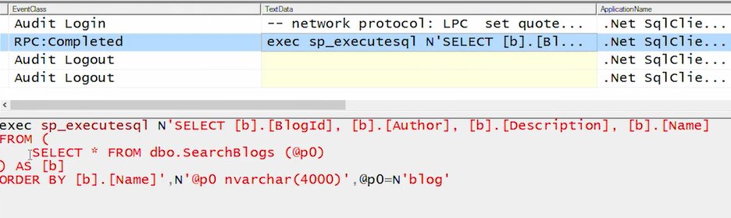
Mix Raw SQL and strongly typed

Slide 84
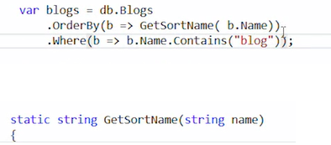

Linq on Client Side
Notes:
Before EF Core this would just failed. GetSortName will be unknown method by SQL Database engine

Slide 85


Reduction of duplicate data when using Include in LINQ query
Notes:
Before it was just 1 command with join and it return back a huge joined result.
Now we will join in memory – that reduce traffic

Slide 86
Key Generation – HiLo Sequence
Preloading primary keys before SaveChanges are invoked.
Keys are fetched as soon as entity is added to the context.
Batch of 10 keys are fetched – will be configurable.
Thread safe – no collisions.
Notes:
In the past, query pipeline required for entire LINQ query to be translated into T-SQL.
With EF Core, portion of LINQ query can be evaluated in the memory.
https://channel9.msdn.com/Blogs/Seth-Juarez/Key-Generation-Strategies-in-Entity-Framework-7

Slide 87
Demo: More demos
Notes:
Demo Script:
Clone source code from https://github.com/rowanmiller/Demo-EFCore and use it for your demos.
Rowanmiller – he is PM in EF Core team

Slide 88

Module Summary
In this module, you learnt about:
Model and its role in MVC pattern
Model development
Entity Framework Core
Scaffolding and scaffolding templates
Entity Framework development approaches
Code-first development and conventions
View-specific Model
Model binding and security
Model development Strategies

Slide 89
Lab: Models

Slide 90


